Slide 1
Revai – AI DRIVEN REVENUE ANALYSIS FOR HOTELS
Milestone - 3
Team – D
Arun Kumar V
Satbir Singh
Chelikani Harshal
N. Akhila
Srilakshmi

Slide 2
Project work flow
💼 Work Flow of the Project
Raw Booking Data ⬇ Cleaned & Modelled Data ⬇ KPI-Based Analysis ⬇ Interactive Dashboards ⬇ Actionable Business Insights

Slide 3
ABOUT THE DATASET
The dataset used is a 3-year Hotel Booking Dataset, containing booking-level information from 2015-2017 such as:
Hotel type (City / Resort)
Market segment
Distribution channel
Guest details (Adults, Children, Babies)
Stay details (Weekday & Weekend nights)
ADR (Average Daily Rate)
Cancellation flag
Arrival date information
Country, customer type, and other booking attributes
The dataset consists of booking-level transactional records, which makes it ideal for KPI-driven analysis.

Slide 4
DATA PREPROCESSING
Before analysis, data cleaning and transformation were performed in Power Query Editor.
Removed unnecessary columns
Handled missing values
Removed duplicate records
Corrected data types
Date fields → Date format
Numeric fields → Whole / Decimal numbers
Categorical fields → Text
5. Standardized categorical values
Ensured consistency across fields like:
Market Segment
Distribution Channel
Customer Type

Slide 5
DATA MODELING
To enrich the dataset, new calculated columns were created:
🔹 Total Stay
Total Stay = Weekend Nights + Weekday Nights
🔹 Total Guests
Total Guests = Adults + Children + Babies
🔹 Revenue
Revenue = ADR × Total Stay

Slide 6
DAX METRICS
After data modeling, DAX was used to create reusable business KPIs.
🔹 1. Average ADR
Average ADR = AVERAGE(hotel_booking_main[adr])
Used to understand pricing trends.
🔹 2. Total Bookings
Total Bookings = COUNTROWS(hotel_booking_main)
Core business metric.
🔹 3. Total Cancellations
Total Cancellations = CALCULATE( COUNTROWS(hotel_booking_main), hotel_booking_main[is_canceled] = 1 )
🔹 4. Total Confirmed
Total Confirmed = CALCULATE( COUNTROWS(hotel_booking_main), hotel_booking_main[is_canceled] = 0 )
🔹 5. Cancellation Rate %
Cancellation Rate % = DIVIDE( [Total Cancellations], [Total Bookings], 0 )

Slide 7
DAX METRICS
After data modeling, DAX was used to create reusable business KPIs.
🔹 6. Total Guests
Total Guests = SUM(adults) + SUM(children) + SUM(babies)
🔹 7. Total Revenue
Total Revenue = SUMX( hotel_booking_main, hotel_booking_main[adr] * (stays_in_week_nights + stays_in_weekend_nights) )
🔹 8. Total Nights
Total Nights = SUM(stays_in_week_nights) + SUM(stays_in_weekend_nights)
🔹 9. Revenue TY (Time Intelligence)
Revenue TY = CALCULATE( [Total Revenue], DateTable[Year] = YEAR(TODAY()) )

Slide 8
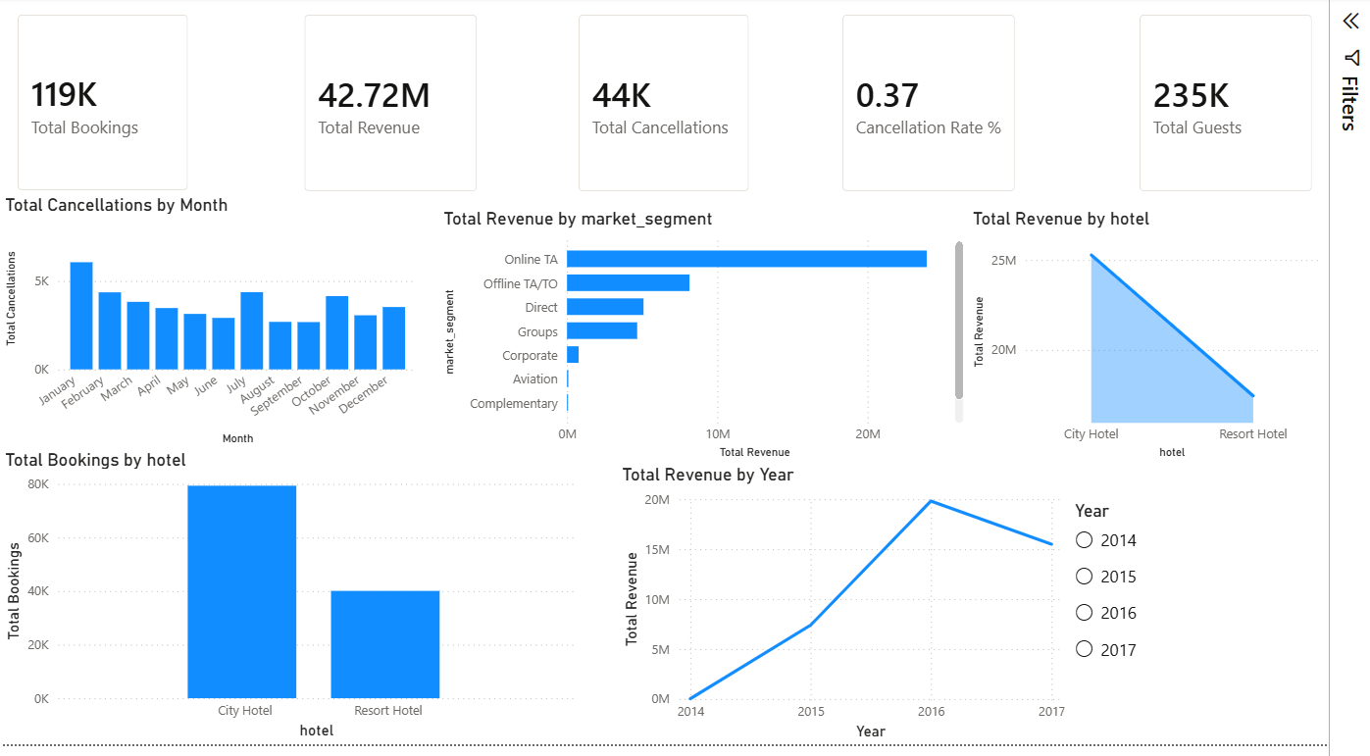
DASHBOARD 1 : REVENUE DASHBOARD
Key KPIs Displayed:
Total Bookings
Total Revenue
Total Cancellations
Cancellation Rate
Total Guests
Insights Enabled:
Revenue by market segment
Year-wise revenue trend
Monthly cancellation pattern
Booking distribution across hotels
Revenue comparison between City & Resort hotels
This dashboard helps management understand where revenue is coming from and which segments are most profitable.

Slide 9
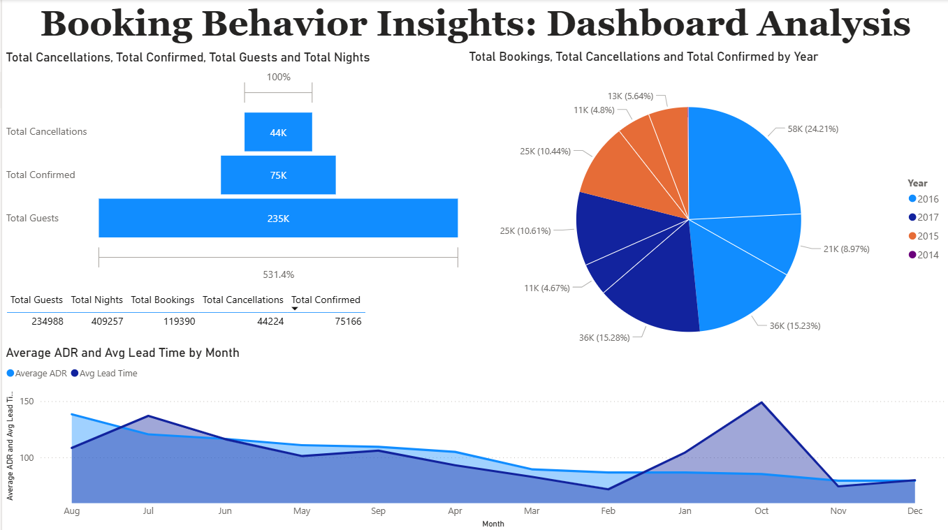
DASHBOARD 2 : BOOKING BEHAVIOUR ANALYSIS
Key Visuals:
Total bookings, confirmations, cancellations
Year-wise distribution
Average ADR vs Average Lead Time
(monthly trend)
Business Value:
Identifies peak booking months
Shows how lead time affects pricing
Enables forecasting and demand planning
This dashboard supports operational planning and pricing strategies.

Slide 10
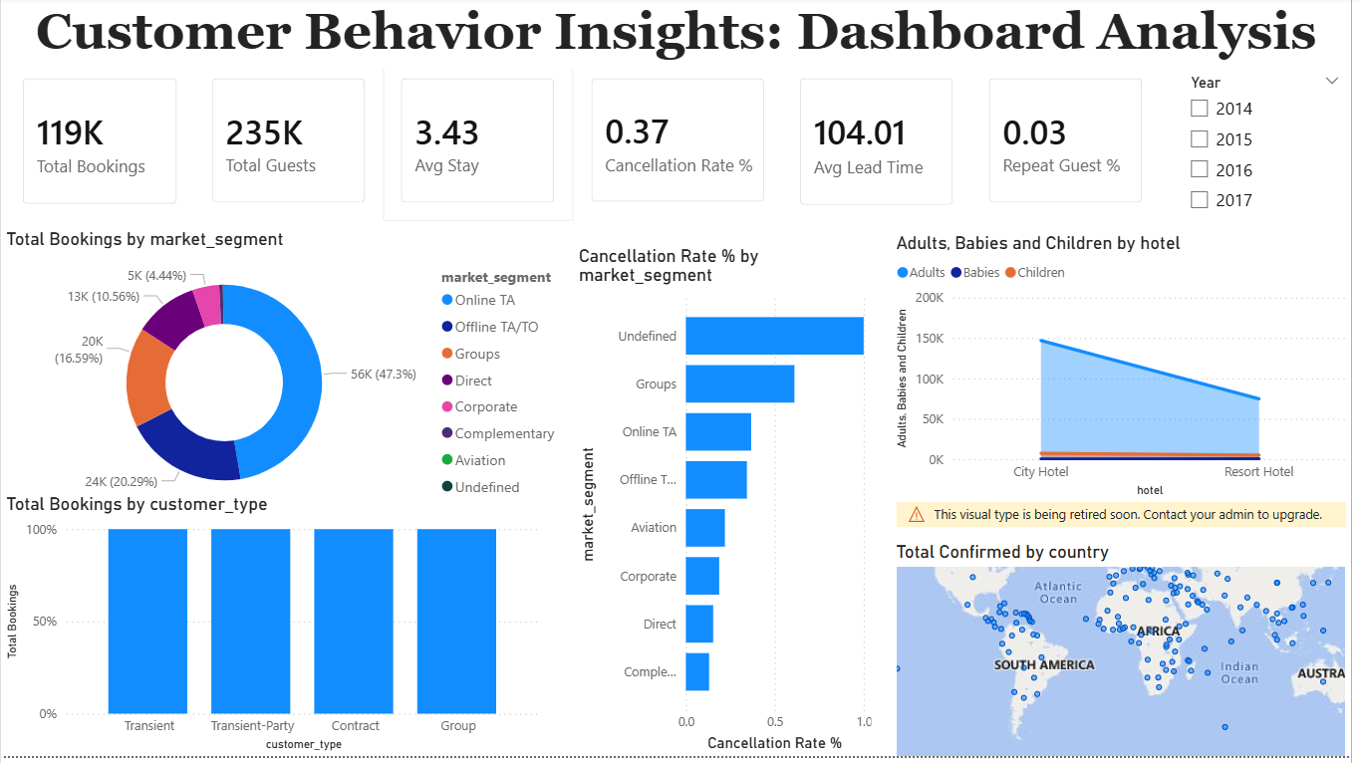
DASHBOARD 3 : CUSTOMER BEHAVIOUR ANALYSIS
Key Insights:
Bookings by market segment
Cancellation rate by segment
Adults, babies, children distribution
Customer type analysis
Country-wise booking distribution
Business Impact:
Helps identify high-risk cancellation segments
Reveals most profitable customer groups
Enables targeted marketing strategies
This dashboard supports customer segmentation and personalization strategies.

Slide 11
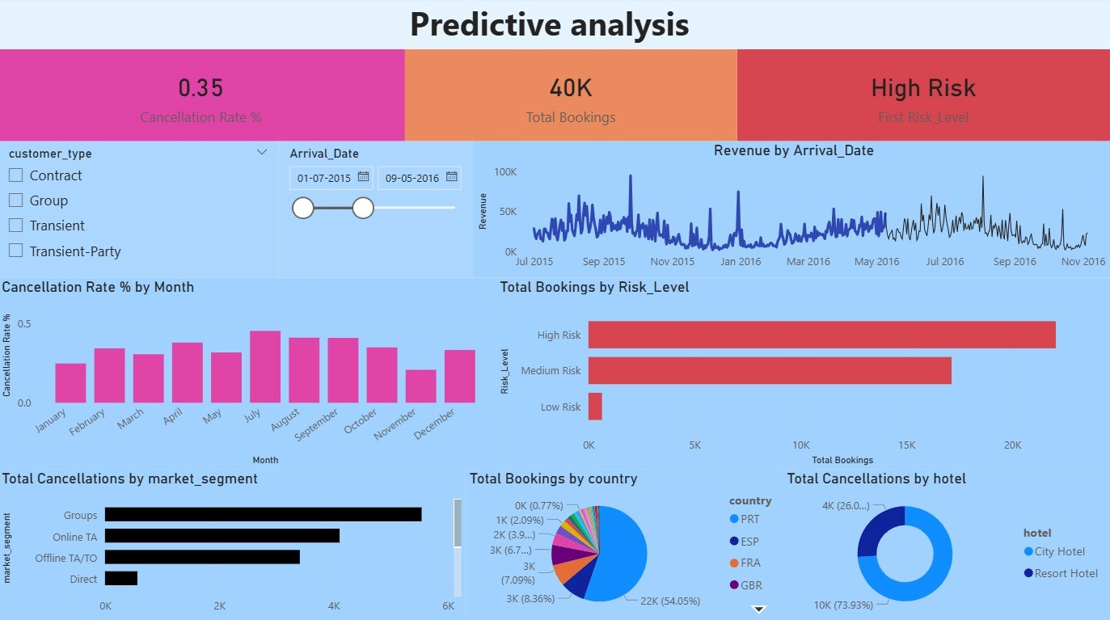
Dashboard 4 : PREDICTIVE ANALYSIS
📌 Key KPIs
Cancellation Rate
Total Bookings
Risk Level
📊 Key Insights
Revenue by Arrival Date
Cancellation Rate by Month
Bookings by Risk Level
Cancellations by Hotel
Bookings by Country
Cancellations by Market Segment
Business Value
This is a Predictive Analysis Dashboard focused on cancellation risk evaluation.

Slide 12
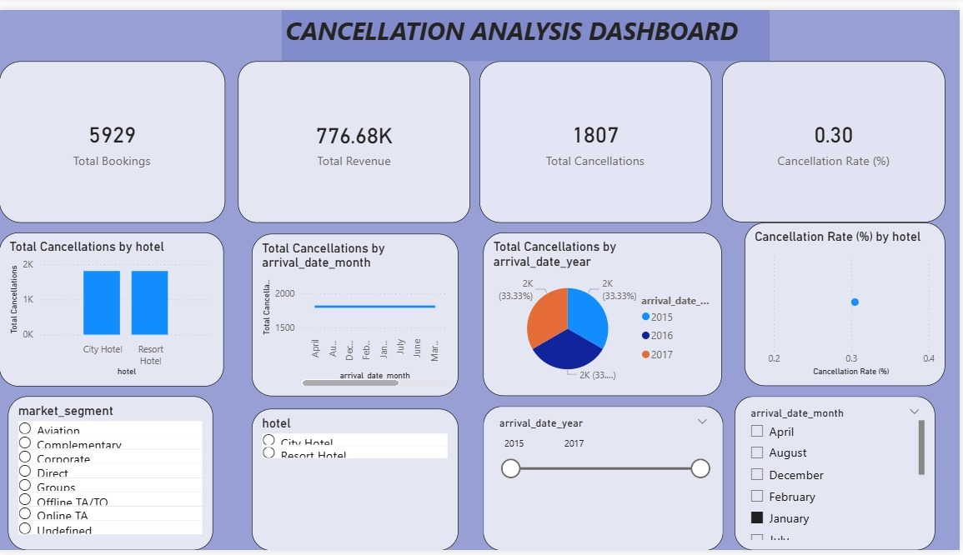
DASHBOARD 5 : CANCELLATION ANALYSIS
Key KPIs Displayed:
Total Bookings Represents total bookings within the selected filters.
Total Revenue Revenue generated in the selected period.
Total Cancellations Total bookings that were cancelled.
Cancellation Rate (%) Indicates the percentage of bookings that were cancelled.
This dashboard supports customer cancellation patterns and analysis

Slide 13
BUSINESS IMPACT
1️⃣ Revenue Optimization
Identified top-performing market segments.
Compared revenue performance between City and Resort hotels.
Analyzed ADR trends across months and years.
Evaluated revenue contribution by customer types.
2️⃣ Improved Occupancy & Demand Planning
Analyzed booking distribution across years and months.
Studied lead time patterns and stay duration.
Evaluated guest volume trends (Adults, Children, Babies).
3️⃣ Risk Monitoring & Revenue Protection
Measured cancellation rate and total cancellations.
Identified seasonal and hotel-level cancellation risks.
4️⃣ Customer Segmentation & Targeting
Segmented customers by market segment and customer type.
Identified repeat guest percentage.
5️⃣ Data-Driven Decision Framework
Created reusable DAX-based KPIs.
Built interactive dashboards with dynamic filters.

Slide 14


